Slide 1

React.js
Course Overview, Trainers, Evaluation
SoftUni Team
Technical Trainers
Software University
https://softuni.bg/

Slide 2

Table of Contents
Course Overview
Course Objectives
Course Topics
Trainers Team
Exams and Evaluation
Learning Resources

Slide 3
Have a Question?
sli.do
#react

Slide 4













SoftUni Diamond Partners

Slide 5

React.js

Slide 6
Course Objectives
The React.js Fundamentals course provides
Fundamental understanding of JSX and React
Covers component-based architecture
Establishes Immutable UI concepts
What is NOT covered?
JavaScript basics and REST communication
Optimization and Web Components

Slide 7
Not for Absolute Beginners
The "React.js" course is NOT for absolute beginners
Requirements
HTML & JS (ES 2016) - intermediate level
Our HTML & CSS Mini Course can help you
Computer English - entry level

Slide 8
Course Topics
React.js overview, JSX syntax
Components, state, props
Events, Lifecycle, HOC, CSS Modules
Routing
Forms
React Hooks and Context API

Slide 9

The Team

Slide 10
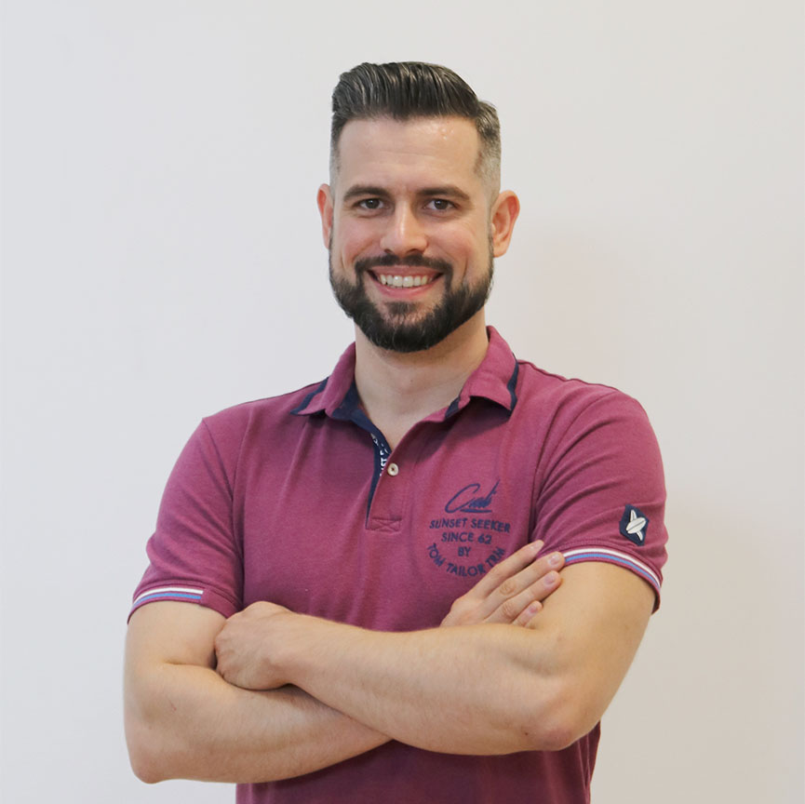
Ivaylo Papazov
Senior Full-Stack Developer @ Motion Software
Technical Trainer @ SoftUni
Experience in JS, C#, Node.js, React, ASP.NET MVC
TelerikAcademy Graduate

Slide 11

Course Organization

Slide 12

Training Duration
Lessons: ~30 hours (onsite + videos)
Practical Workshop (in class): ~30 hours
Project Defense: 15 minutes
Defense date: 11 April 2021
Retake defense date: 17 April 2021

Slide 13


Scoring System for the Course
Theoretical Exam 5%
Project Defense 95%
Evaluation

Slide 14
Theoretical Exam
You will have 30 minutes once you enter
Multiple-choice with 1 or more correct answers
English
Automated quiz system
Available online the day before the practical exam
You can submit your answers just one time

Slide 15

Learn to Search Online
The course assignments require searching online
This is an important part of the learning process
Some exercises intentionally have no hints
Learn to find solutions!
Software development includes everyday searching and learning
No excuses, just learn to study!
Developers learn new technologies, tools, languages every day!

Slide 16




Course Web Site, Forum and FB Group
Official web site:
Official discussion forum:
Official Facebook group:
Official SoftUni JavaScript Community:
https://softuni.bg/trainings/3315/reactjs-march-2021
softuni.bg/forum/categories/107/
https://www.facebook.com/groups/ReactJSMarch2021
facebook.com/groups/SoftUniJavaScriptCommunity/

Slide 17
https://softuni.bg/courses/react-js

Slide 18




Trainings @ Software University (SoftUni)
Software University - High-Quality Education and Employment Opportunities
softuni.bg
Software University Foundation
http://softuni.foundation/
Software University @ Facebook
facebook.com/SoftwareUniversity
Software University Forums
forum.softuni.bg

Slide 19

License
This course (slides, examples, demos, videos, homework, etc.) is licensed under the "Creative Commons Attribution-NonCommercial-ShareAlike 4.0 International" license

